Slide 1
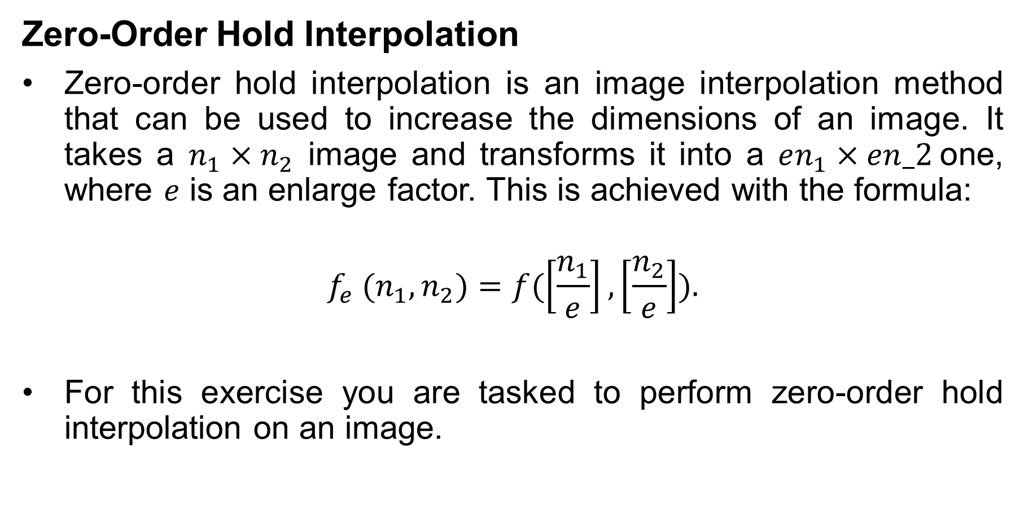
Image Processing
Zero-Order Hold Interpolation
Zero-order hold interpolation is an image interpolation method that can be used to increase the dimensions of an image. It takes a $n_{1}×n_{2}$ image and transforms it into a $en_{1}×en_2$one, where $e$ is an enlarge factor. This is achieved with the formula:
$$f_{e} (n_{1},n_{2})=f(\left[\frac{n_{1}}{e}\right],\left[\frac{n_{2}}{e}\right]).$$
For this exercise you are tasked to perform zero-order hold interpolation on an image.

Slide 2

Image Processing
Zero-Order Hold Interpolation
The algorithm takes as input and image and an enlarge factor and performs zero-order hold interpolation by copying each pixel of the original image $e$ times to the output image.
Finally, the resized image is displayed.

Slide 3


Image Processing
Zero-Order Hold Interpolation
Input (left) and output (right) example of a decimated image with an enlarge factor of 2.

